Slide 1
MCAS Grade 8 Civics Informational Session
The Office of Student Assessment Services
November 8, 2023

Slide 2
Presenters
Ann Marie Gleeson, History & Social Science Test Development Coordinator
Marissa Roque, MCAS Civics Test Development Specialist

Slide 3
Logistics for This Session
Use the Q&A feature to ask a question.
We will answer some questions aloud at specified times during this training session, and we will email the Q&A afterwards.
Type your questions anytime, but we may not answer them in real time as some questions may be covered during the presentation.
Use the thumbs-up icon to “upvote” someone else’s question.
Email student-specific questions to mcas@doe.mass.edu instead of asking here.
This session is being recorded and will be available in about a week in the MCAS Resource Center, along with the slides.
Slides were also emailed out beforehand, and are being posted in the chat.
Closed captioning has been enabled for participants who need it.

Slide 4
Today’s Agenda
Overview and Test Design for the 2024 Civics Field Test
Local-Level Performance Tasks
State-Level Performance Tasks
End-of-Course (EOC) Test
Resources
2024 Field Test Administration Logistical Information
Questions and Next Steps

Slide 5
1. Overview and Test Design for the 2024 Civics Field Test

Slide 6
DESE Charge
Assess the 2018 History and Social Science Framework for Civics (Grade 8)
Integrate performance assessment and computer-based test components
Minimize testing time

Slide 7
State Initiatives
History and Social Science MCAS Program
Suspended
An Act to Promote and Enhance Civic Engagement
2008
June 2018
Nov. 2018
New History and Social Science Curriculum Framework

Slide 8
MCAS Civics Timeline
2021 Pilot (voluntary)
Administered performance tasks and EOC test questions
2022 Pilot (voluntary)
Refined test design and administered additional performance tasks and EOC test questions in expanded pilot. Released practice test (performance task and EOC test).
2023 EOC Test Pilot (voluntary)
Administered EOC test questions and released school- and state-level results with test questions.
2024 Field Test
(required)
Required statewide field test for all schools serving grade 8 students.
2025 Operational Test (required)
Anticipated first operational year with results reported to schools and districts.
2019 DESE Begins Development
Beginning of development process

Slide 9
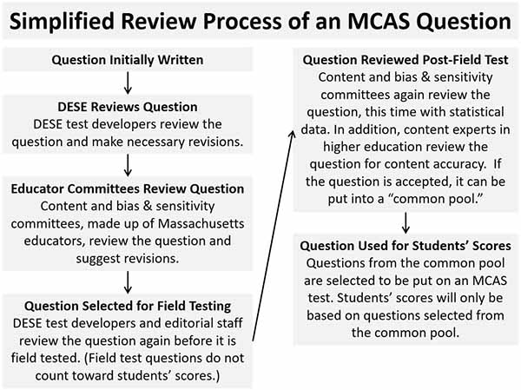

Slide 10
Grade 8 Civics Assessment Development Committee (ADC)
Convened first committee in 2019
12 grade 8 civics educators and curriculum coordinators
Review all test questions, scoring notes, and data results
Irene LaRoche, Amherst Regional Middle School, Grade 8 Civics ADC Member

Slide 11
Grade 8 Civics Test Design
Grade 8 Civics Test Design
State-Level Performance Task
(covers one of the seven civics topics
in the Framework)
End-of-Course Computer-based Test
(covers full breadth of grade 8 civics standards)
Selected-response and constructed-response questions
Administered on TestNav
Selected-response questions only Administered on TestNav
Local-Level tasks posted on DESE website to support assessment of task topics. (Optional)
​ | Points​
State-Level Performance Task​ | 14​
End-of-Course Computer-based Test​ | 36
Total​ | 50​

Slide 12
Reporting Categories
All questions are coded to a content standard and a HSS practice.
Civics Content Reporting Categories | Percentage of Test +/- 5%
Foundations and development of the U.S. political system & government (FG: Topics 1 & 2) | 32%
Institutions and structure of U.S. government & Massachusetts state and local governments (GS: Topics 3 & 6) | 33%
Rights and responsibilities, the U.S. Constitution, and news & media literacy (RR: Topics 4, 5, & 7) | 33%
HSS Practices Reporting Categories | Percentage of Test +/- 5%
Knowledge, skills, and dispositions (standard 1) | 15-20%
Questioning and solving civics-related problems (standards 2, 7) | 15-20%
Analyzing points of view and credibility from sources (standards 4, 5) | 20-35%
Developing explanations using reasoning and evidence from sources (standards 3, 6) | 20-35%

Slide 13
State Task and EOC Test Questions
Will assess both the civics content and the HSS practice standards
Students will use civics content knowledge and skills to explain and describe civics concepts, support claims with evidence, and analyze sources and graphics
Most items are based on stimuli including text, photographs, images, charts, data, etc.
More information about these components of the test will be describe later in the presentation.

Slide 14
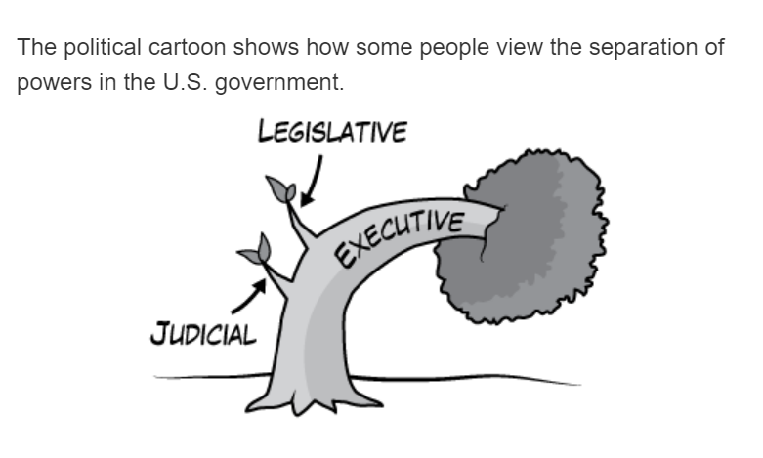
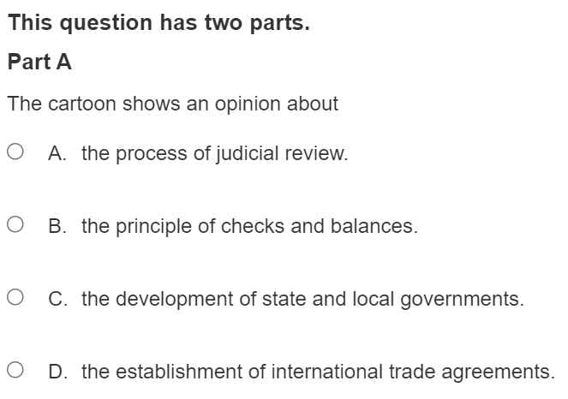
Example of Two-Point Test Question
8.T7.6. Analyze the point of view and evaluate the claims of an editorial, editorial cartoon, or op-ed commentary on a public policy issue at the local, state, or national level (e.g., a mayoral or school committee decision, an action by a state legislature or Governor, a vote in Congress or an action by the President).
PS4. Analyze the purpose and point of view of each source; distinguish opinion from fact.

Slide 15
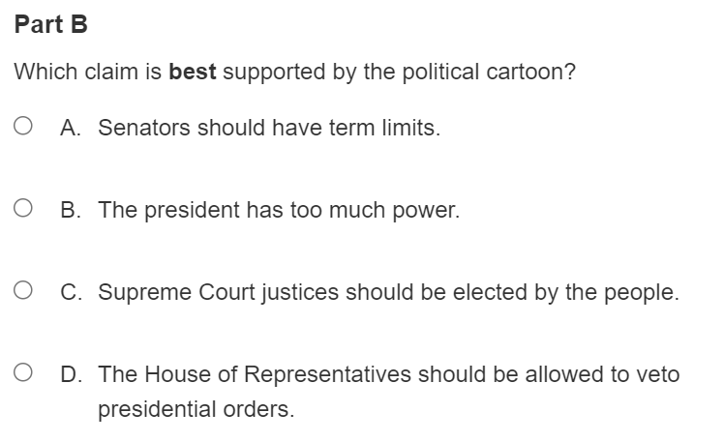
Example of Two-Point Test Question (cont'd)
8.T7.6. Analyze the point of view and evaluate the claims of an editorial, editorial cartoon, or op-ed commentary on a public policy issue at the local, state, or national level (e.g., a mayoral or school committee decision, an action by a state legislature or Governor, a vote in Congress or an action by the President).
PS4. Analyze the purpose and point of view of each source; distinguish opinion from fact.

Slide 16
2. Local-Level Performance Tasks

Slide 17
Local-Level Performance Tasks
Purpose of these tasks is to prepare students for the State-Level Task
Administration of local-level classroom tasks is optional, though strongly recommended
No data collected by the state
Can be used for formative or summative purposes
Should be completed after regular instruction has occurred for the topic being addressed as an assessment activity
Include group work and discussions
Ask students to analyze and evaluate sources to describe and explain civics concepts
May be printed or distributed digitally for students to complete on a computer

Slide 18
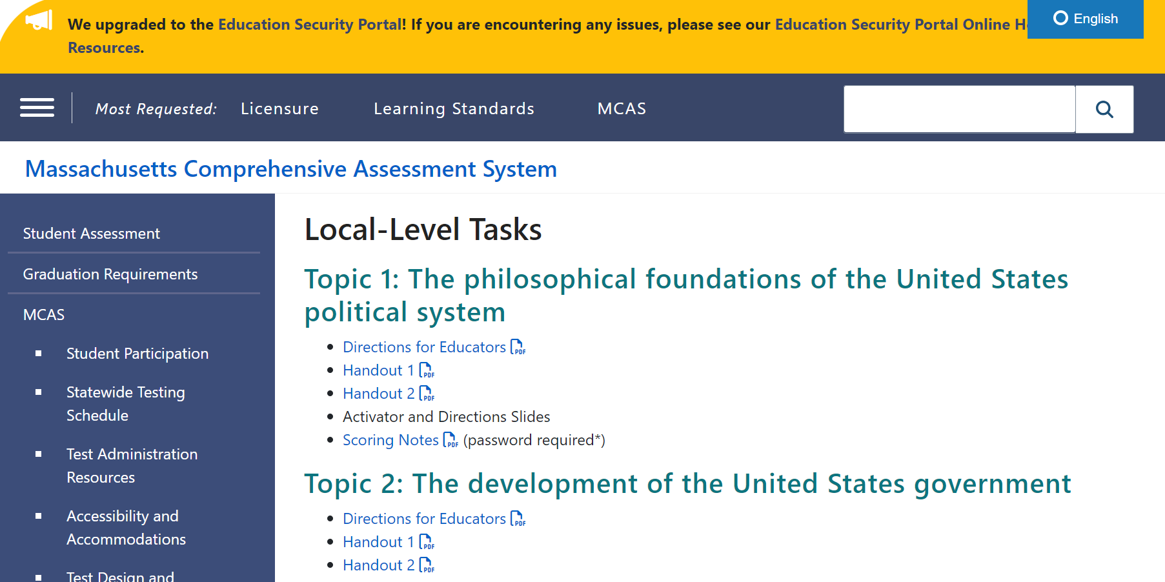
Where Can You Find the Local-Level Tasks?
Seven local-level performance tasks have been posted on the DESE Website.
Materials include educator directions, student handouts, scoring notes.
Scoring Notes are password-protected.
https://www.doe.mass.edu/mcas/tdd/hss.html?section=localtasks

Slide 19
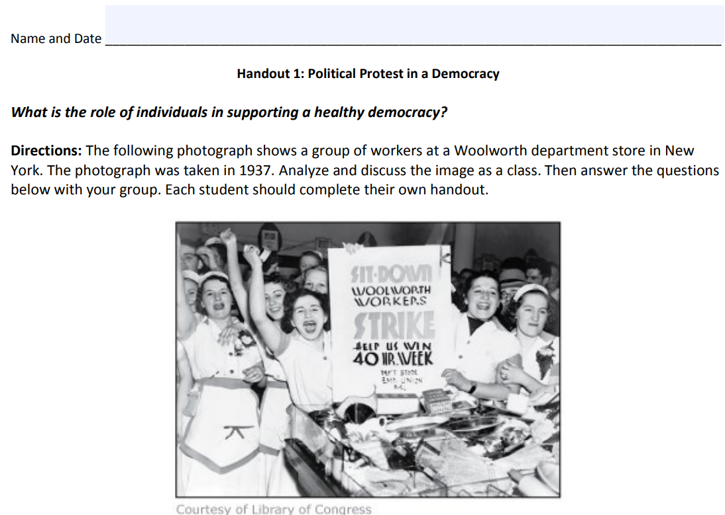
Example of Local-Level Performance Task
Most tasks begin with an activator activity.
1. Explain what the individuals in the photograph want to achieve. Use details from the image to support your reasoning.
2. Explain how an activity like the one shown in the photograph supports a healthy democracy.

Slide 20
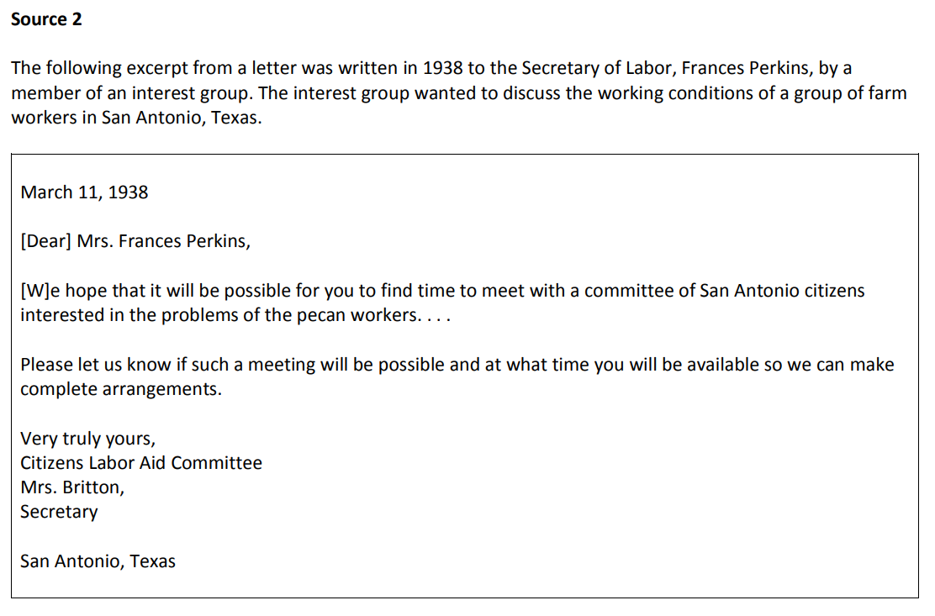
Example of Local-Level Performance Task
Students read and discuss primary and secondary sources in small groups.

Slide 21
Example of Local-Level Performance Task
Each question assesses one or more content standards from the topic, and one or more practice standards.
Content Standard 8.T4.8. Explain the importance of individuals working cooperatively with their elected leaders.
Practice Standard 6 Argue or explain conclusions, using valid reasoning and evidence.

Slide 22
Modifying Local-Level Performance Tasks
Teachers may modify these tasks and adapt them to their classrooms. Modifications may include, but are not limited to:
adapting sources, presentations, instructions, or student handouts to add clarity for specific populations (such as English learners)
changing the scoring notes by adding additional student answers
incorporating previous class work during discussions
administering a task in more than one class session

Slide 23
Local-Level Performance Task
Are there any questions about using the local-level performance task materials?

Slide 24
3. State-Level Performance Tasks

Slide 25
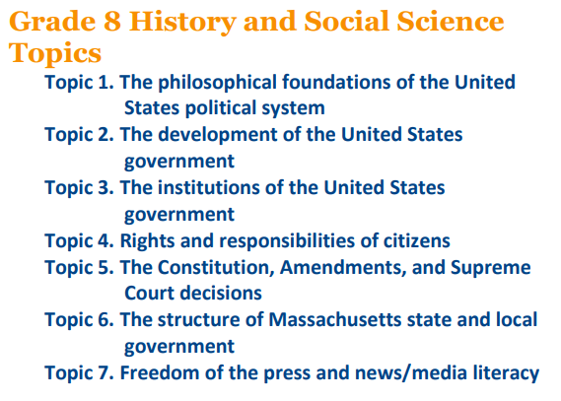
State-Level Performance Tasks
Each state-level performance task will be centered on one of the seven topics from the civics standards
Tasks consist of questions based on primary and secondary sources. It is estimated that one task will take approximately 45–50 minutes to complete.
State-Level Performance Task Practice Test

Slide 26
State-Level Performance Tasks
Students will take one state-level performance task. Each task is worth a total of 14 points and consists of the following:
1 one-point, selected-response opening item
3 mini-modules
Each based around a source or set of sources
Each consists of 2 one-point, selected-response questions followed by 1 one-point, constructed-response question
1 four-point, hand-scored question

Slide 27
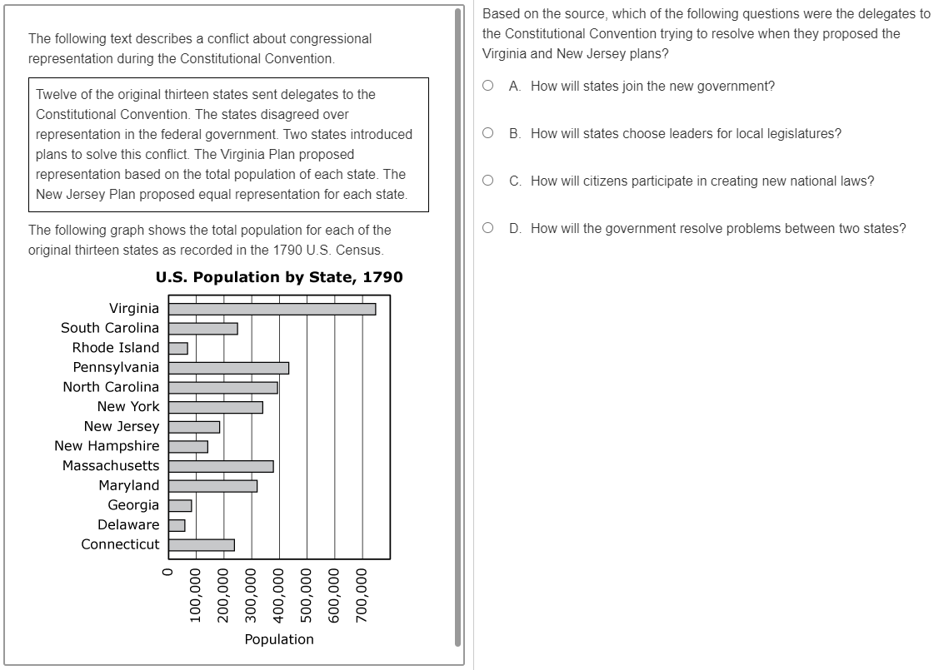
Example of State-Level Performance Task Question
Mini-Module
Question 1
Selected-response
Machine-scored
1 point

Slide 28
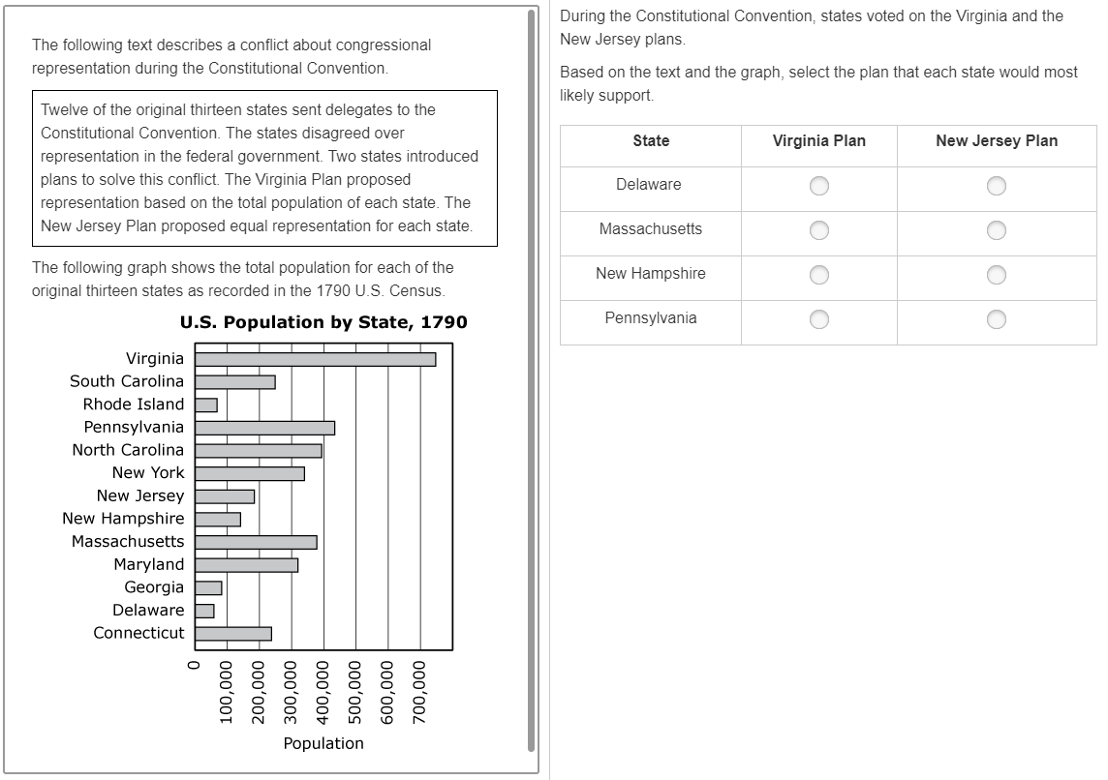
Example of State-Level Performance Task Question
Mini-Module
Question 2
Multi-select
Machine-scored
1 point

Slide 29
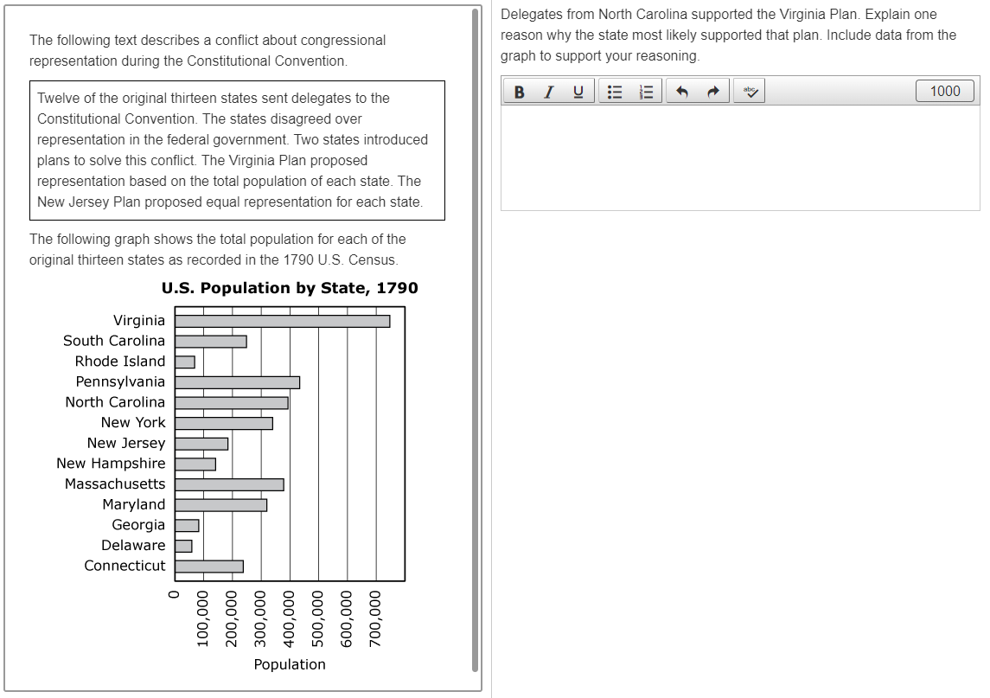
Example of State-Level Performance Task Question
Mini-Module
Question 3
Constructed-response
Hand-scored
1 point

Slide 30
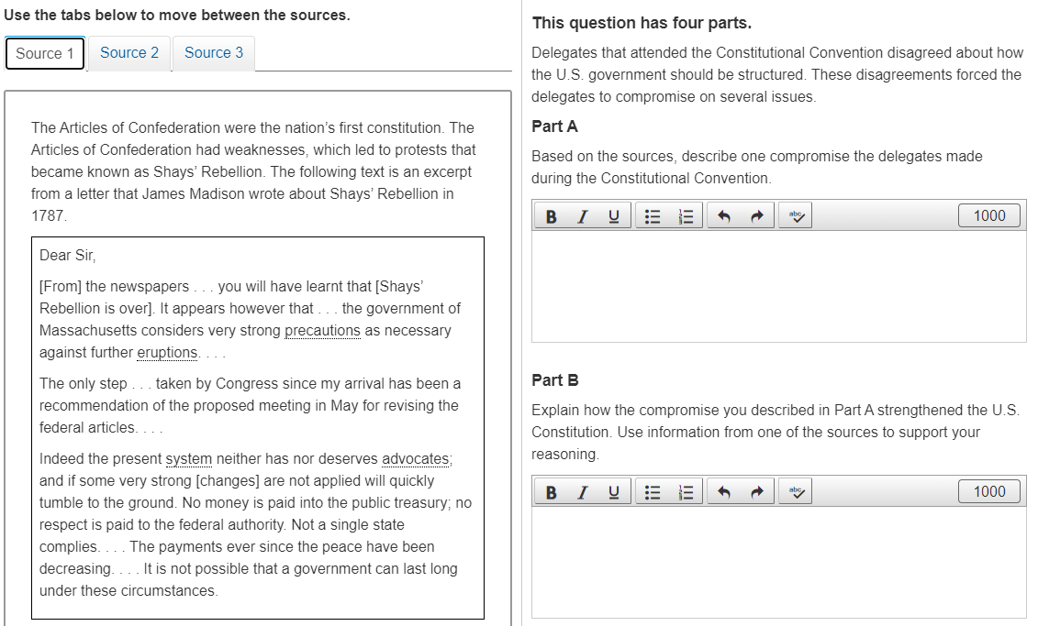
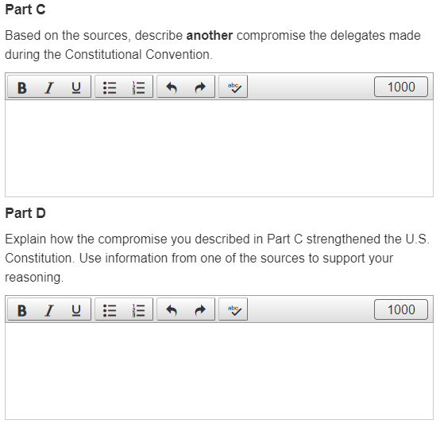
Example of State-Level Performance Task Question
Constructed-response, hand-scored, 4 points (1 point for each part)

Slide 31
State-Level Performance Tasks
Are there any questions about the state-level performance tasks?

Slide 32
4. End-of-Course Test (EOC)

Slide 33
End-of-Course Test
Approximately 36–38 test questions
Machine-scored/selected-response
Many questions based on a text source or graphic
Discrete items and item sets
Estimated 50–60 min to complete

Slide 34
5. Resources

Slide 35
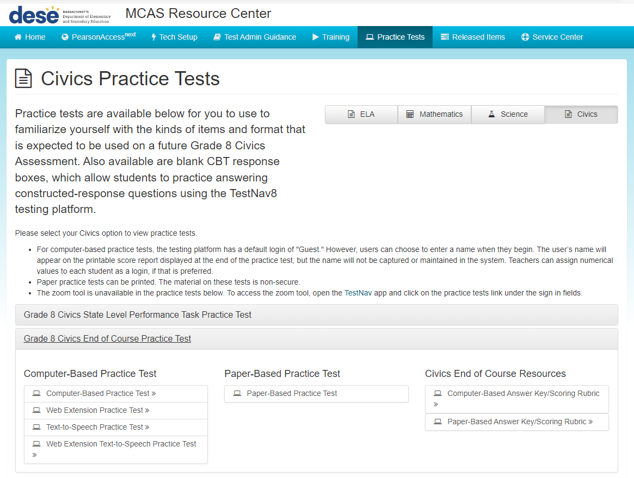
Practice Tests http://mcas.pearsonsupport.com/student/practice-tests-hss/

Slide 36
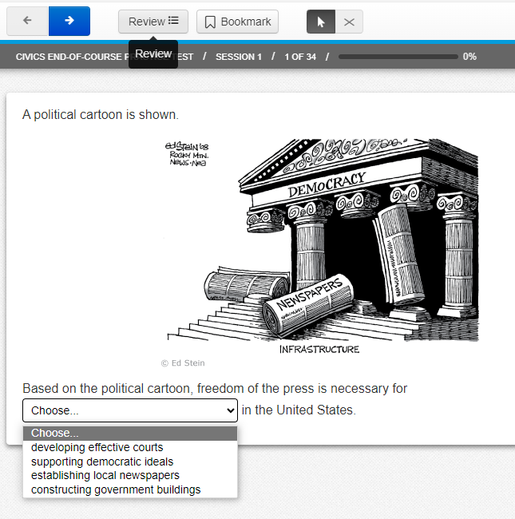
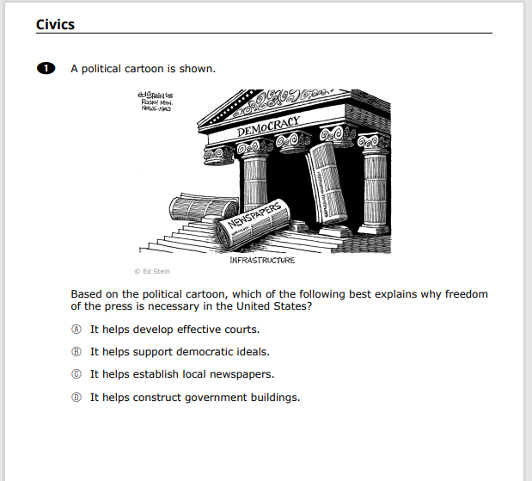
Practice Tests http://mcas.pearsonsupport.com/student/practice-tests-hss/
Computer-Based Practice Test
Paper-Based Practice Test

Slide 37
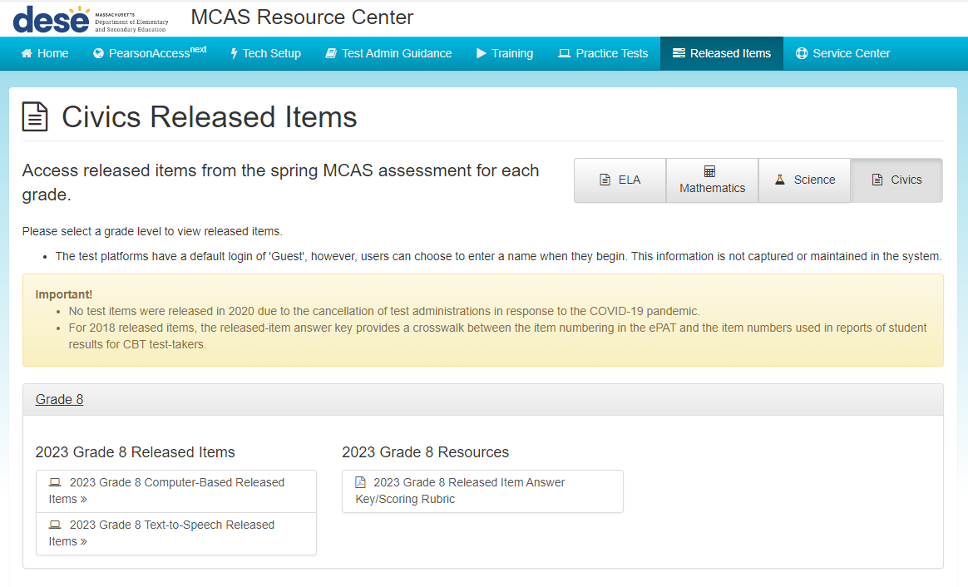
Released Items (from 2023 pilot) http://mcas.pearsonsupport.com/released-items/civics/

Slide 38
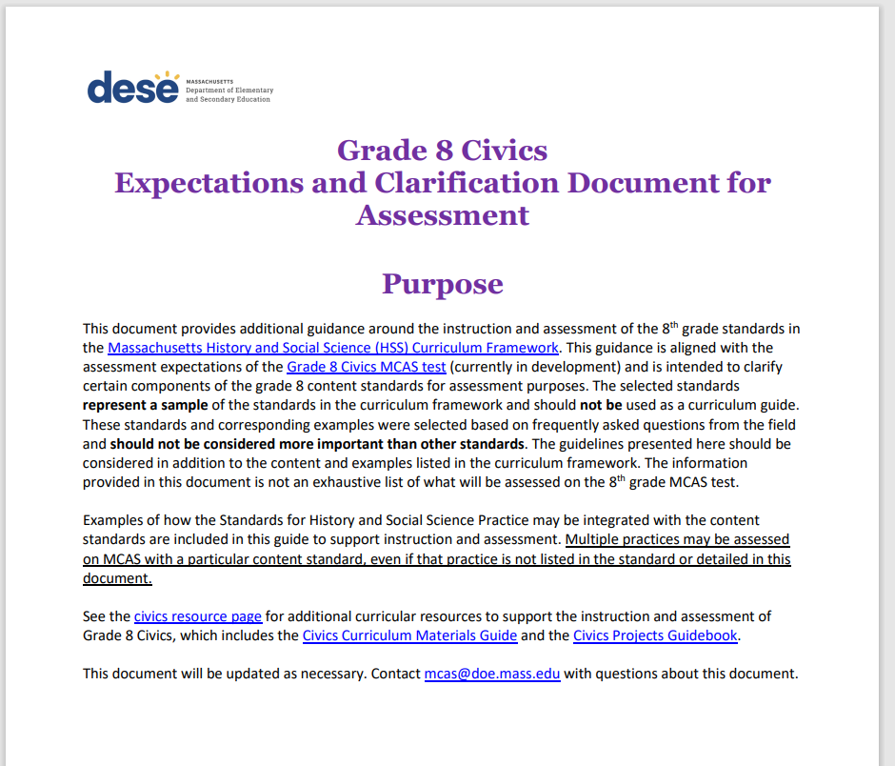
Grade 8 Civics Expectations and Clarification Document for Assessment https://www.doe.mass.edu/mcas/tdd/g8-civics-assessment.pdf
Developed by DESE’s Office of Student Assessment Services in collaboration with the Center for Instructional Support (CIS)
Provides additional guidance for learning and assessment expectations of the grade 8 civics standards
Represents a sample of the standards in the Curriculum Framework and should not be used as a curriculum guide
Selected based on frequently asked questions from the field and should not be considered more important than other standards
Document will be updated as needed

Slide 39
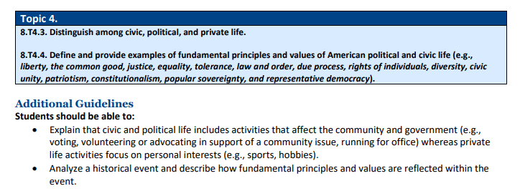
Grade 8 Civics Expectations and Clarification Document for Assessment
https://www.doe.mass.edu/mcas/tdd/g8-civics-assessment.pdf

Slide 40
6. 2024 Field Test Administration Logistical Information

Slide 41
2024 MCAS Civics Field Test Overview
Purpose of the field test is to evaluate test questions, including both state-level performance tasks and end-of-course (EOC) test questions
April 29–June 7, 2024: Administration window
Each student that participates will take a state-level performance task and EOC questions
Each component may be administered at any time during the window; they do not have to be administered on consecutive days
State-level performance task should be administered before the EOC test

Slide 42
Field Test Topic Assignments
Each school has been randomly assigned to one state-level performance task based on 1 of the 7 civics topics
Schools may use the corresponding local-level performance task materials during the school year to help prepare students

Slide 43
Field Test Participation Requirements
Every school that enrolls more than 10 grade 8 students will be expected to have 50% of their students participate, with exceptions for accommodations.
Some students who need certain accommodations will be exempted from participation.
Text-to-speech will be available
No paper-based accommodations will be available
Schools may enroll all grade 8 students (if a school wants to do so)

Slide 44
Additional Resources on the DESE MCAS Website
Resource | Description
Civics Field Test Administration Information | Resources for administering the 2024 Civics Field Test (e.g., administration manuals, test schedule, topic assignments)
Home page | Access MCAS headlines and links to MCAS site (e.g., test schedule, test designs, training)
Student Assessment Updates | Biweekly email with important updates about the MCAS program If you do not already receive this email, subscribe at this link: http://eepurl.com/ghSOhH
MCAS Pre-Administration Guide | Instructions and roles/responsibilities for principals/test coordinators, new staff, and technology coordinators for tasks to complete prior to MCAS test administration, supplementing test administration manuals

Slide 45
7. Questions and Next Steps

Slide 46
Questions
Additional questions about the field test?

Slide 47
Next Steps
Today: Complete the evaluation form.
Responses are associated with the name and email address used to log in.
Email your input to mcas@doe.mass.edu if you have problems accessing or completing the form.
Within one week:
Receive an email with the Q&A from this session
Recording will be available

Slide 48
Contact Information
MCAS Service Center
DESE Student Assessment Services
Questions on logistics and technology (e.g., PearsonAccess Next, SR/PNP, TestNav)
Web: mcas.pearsonsupport.com
Email: mcas@cognia.org
Phone: 800-737-5103
Policy questions (e.g., student participation, accommodations, “I have a student who…”)
Web: www.doe.mass.edu/mcas
Email: mcas@doe.mass.edu
Phone: 781-338-3625

Slide 49
THANK YOU
The Office of Student Assessment Services
781-338-3625
mcas@doe.mass.edu
www.doe.mass.edu/mcas
75 Pleasant Street, Malden, MA 02148

